Slide 1
Forecasting Sales in R with Time Series Models and Stochastic Gradient Boosting

Slide 2
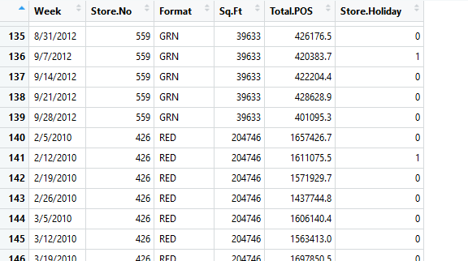
Project analysis slide 2
The Problem
A retailer wishes to forecast total POS for several of its stores for the coming month
Data is provided at the store level, with various features from the retailer

Slide 3
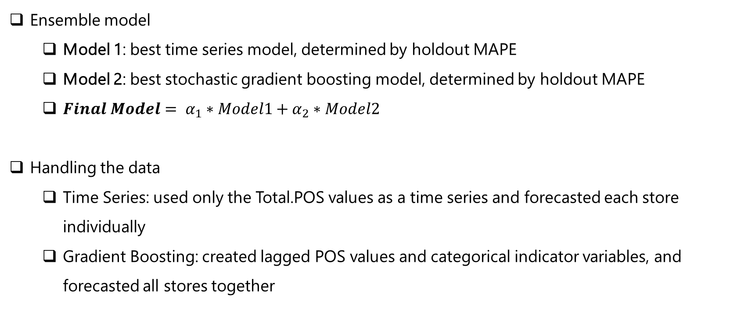
Project analysis slide 2
Modeling Approach
Ensemble model
Model 1: best time series model, determined by holdout MAPE
Model 2: best stochastic gradient boosting model, determined by holdout MAPE
${Final Model= α}_{1}∗Model1+α_{2}∗Model2$
Handling the data
Time Series: used only the Total.POS values as a time series and forecasted each store individually
Gradient Boosting: created lagged POS values and categorical indicator variables, and forecasted all stores together

Slide 4
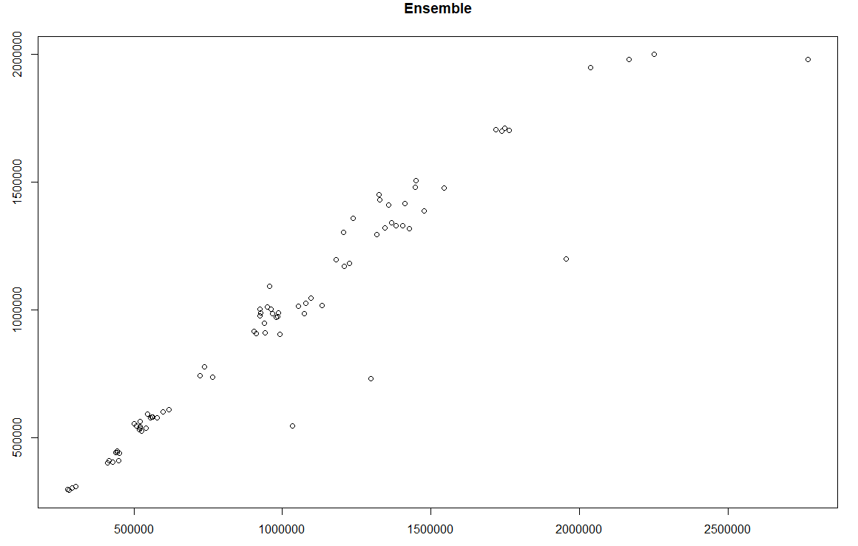
Project analysis slide 2
Results
Time Series models: MAPE of 7.69%
Gradient Boosting model: MAPE of 7.86%
Ensemble model: MAPE of 7.4%

